Slide 1
PRACTICAL#14
DECISION TABLES

Slide 2
DECISION TABLES
Decision table provides a handy and compact way to represent complex business logic.
In a decision table, business logic is well divided into conditions, actions (decisions) and rules for representing the various components that form the business logic.
Decision table is a way to decision making that involves considering a variety of conditions and their interrelationships, particular for complex interrelationships. People use decision table to represent and discover business logic, which ultimately lead to better business.

Slide 3
Consists of three parts
Condition rows
Lists condition relevant to decision
Action rows
Actions that result from a given set of conditions
Rules
Specify which actions are to be followed for a given set of conditions

Slide 4
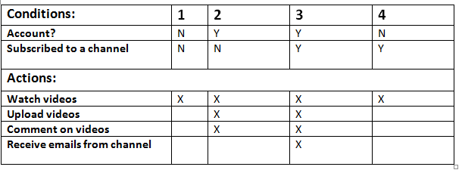
Example (Youtube)

Slide 5
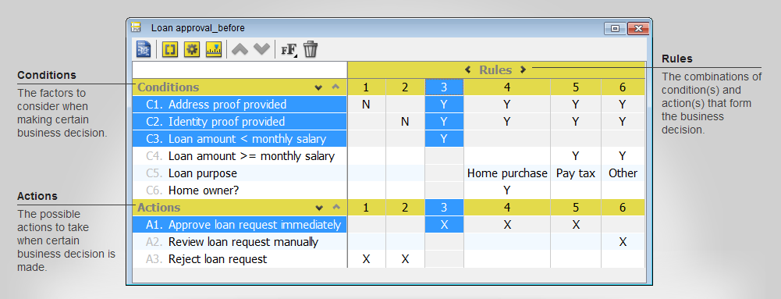
Another Example

Slide 6
Why use decision tables?
Powerful visualization
Compact and structured presentation
Preventing errors is easier
Avoid incompleteness and inconsistency
Modular knowledge organization
Group related rules into single table
Combine tables to achieve decision

Slide 7
TASK
Define an application of your choice and make a decision table for that application’s features.

